Slide 1
Support Vector Machine, Decision Tree, and Neural Network
PHYS591000 Spring 2021
Reference: https://indico.cern.ch/event/619370/ Lecture by Michael Kagan

Slide 2
Motivation: Non-linear classification/regression
?
LDA/linear hypothesis doesn’t seem to work...

Slide 3
Outline
We need fancier machine learning algorithms!
Part I: Support Vector Machine
Part II: Decision Tree
Part III: Neural Network

Slide 4
Part I: Support Vector Machine

Slide 5
Classification: which line?
All three lines can be used to classify signal (red) and background (blue) events. Which one to use?
Signal
Background

Slide 6
Classification: which line?
This line will classify the test sample (black) as background, even though it is closer to the block of signals.
Signal
Background
Test

Slide 7
Classification: which line?
Similarly the test sample will be classified as signal, despite being closer to the background events.
Signal
Background
Test

Slide 8
Classification: which line?
Apparently this ‘central’ line is the best choice: the one with max margin
Margin: the shortest distance between the observations (dots) and the threshold (line)
Signal
Background

Slide 9
Support Vector Machine (SVM)
The max-margin hyperplane (when more features are used) is determined by the data points which lie nearest to it. → ‘Support vectors’
Signal
Background

Slide 10
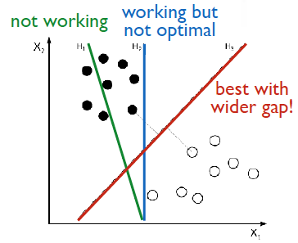
Support Vector Machine (SVM)
Courtesy of Prof. Kai-Feng Chen (NTU)
The goal of SVM is to divide the categories with a gap (margin) as wide as possible

Slide 11
Soft margin
When there are outliers (the highlighted blue dot), choosing the line with max hard margin will classify the test sample (black) as background even though it is closer to most of the signal events.
Signal
Background
Test

Slide 12
Soft margin
Instead we choose the line with max soft margin by allowing a little bit misclassification, so that the model is less sensitive to outliers in the training data.
Signal
Background
Test

Slide 13
Soft margin
ξ
The amount of misclassification can be represented by the distance ξ
A ‘regularization’ term CΣ_{i}ξ_{i} can be added to the SVM fit. C is a hyperparameter to be determined.
Signal
Background

Slide 14
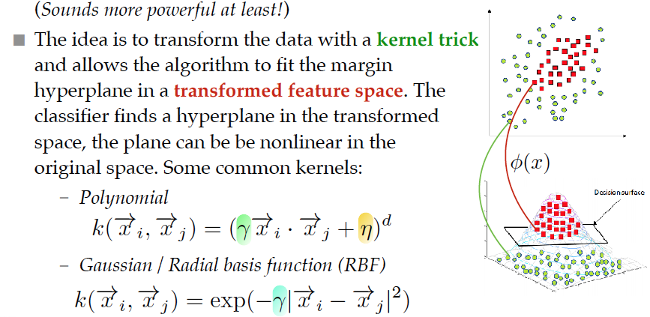
SVM: Nonlinear kernel
SVM can be used for non-linear separation
Courtesy of Prof. Kai-Feng Chen (NTU)

Slide 15
Part II: Decision Tree

Slide 16
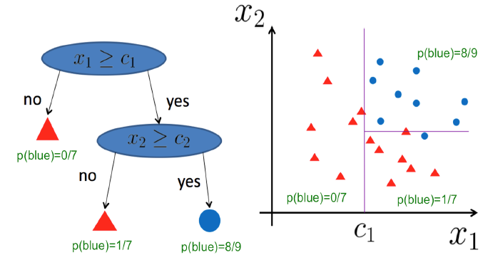
Decision Tree
Ask a series of Y/N questions and separate the data based on the answers
M. Kagan

Slide 17
Decision Tree
Ask a series of Y/N questions and separate the data based on the answers
root
node
leaf
M. Kagan

Slide 18
Decision Tree
Easy to train but prone to overfitting (in principle can keep splitting until every training event is correctly classified)
Should specify
Max Tree depth
Min samples used in a node
Max number of leaves ...

Slide 19
Ensembles of Decision Tree
To make a decision tree flexible (easier to generalize) we can combine many trees and take the ‘average’ output:
Random Forest (RF): Train a set of trees by randomly selecting features and samples. Outcome = the output which gets the most ‘votes’ by the trees
Boosted Decision Trees (BDT): Train N models in sequence and give more weights to wrongly classified events each time. Output = weighted votes from each model

Slide 20
Part III: Neural Network

Slide 21
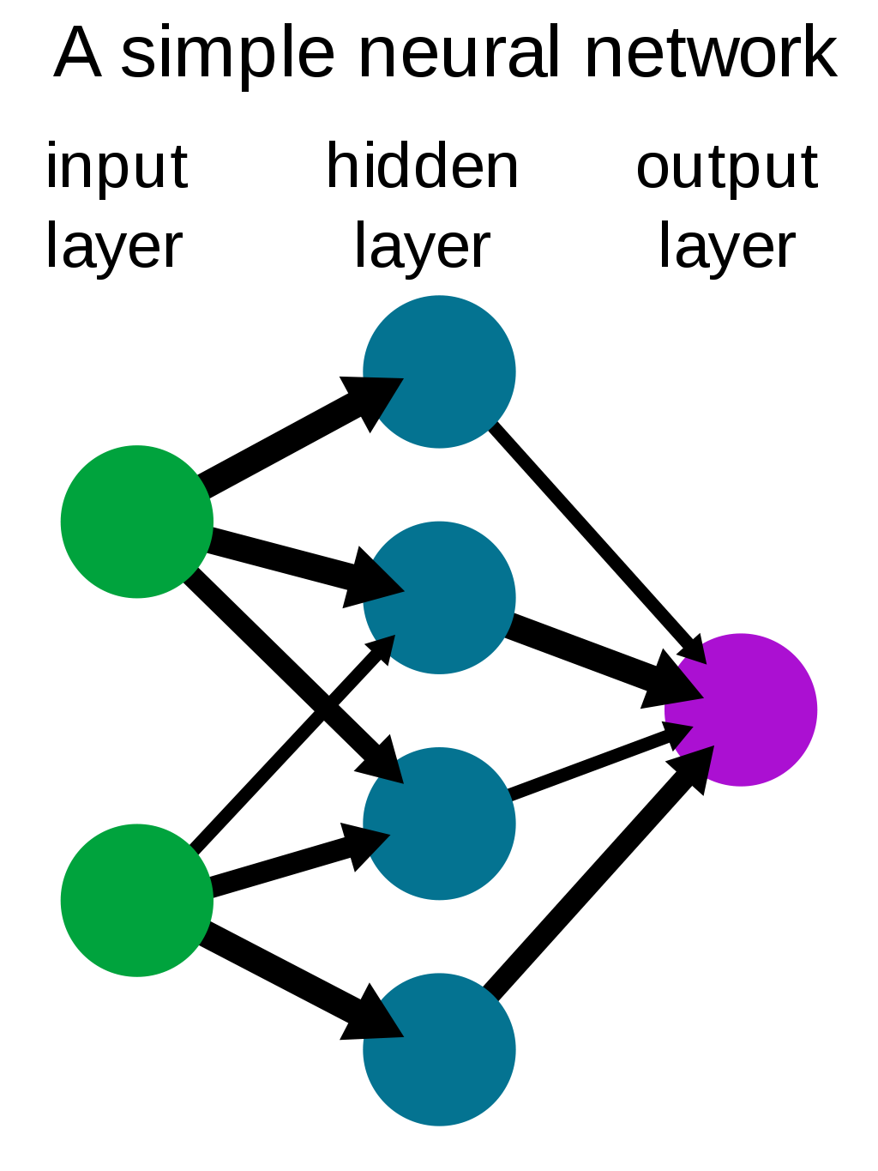
Neural Network
Artificial Neural Network (ANN), or just neural network (NN), is a model which tries to simulate the functions of biological neural networks.
Each circle on the plot is a ‘neuron’. Can have multiple neurons for a layer. Can have many hidden layers.
Source: Wikipedia

Slide 22
How does a neuron work?
A neuron works like a ‘switch’: its output is determined by summing over inputs with different weights (importance of each input), plus a bias (a ‘threshold’ value for this neuron)
W₁, W₂: weights
b: bias
X₁ * W₁
+ b
X₂ * W₂

Slide 23


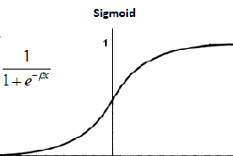
How does a neuron work?
And feeds into an activation function which makes the output behave like a ‘smoothed’ on/off
W₁, W₂: weights
b: bias
X₁ * W₁
σ(z)
‘On’
+ b
Activation function
‘Off’
X₂ * W₂
z

Slide 24
Neural Network Information Flow
If the NN processes the information only in one way (input → output without any loops) it is called feedforward.
Focus on feedforward NN now. Later we’ll talk about RNN (recurrent NN) which is non-feedforward.
Flow of information
Source: Wikipedia

Slide 25

How to Train Neural Network
The goal is find optimal weights (w_{i}) and biases (b_{j}) which minimize an objective function (loss function). A typical choice is the mean square error (MSE):
Number of data points
True value y for input x
Current output given input x

Slide 26
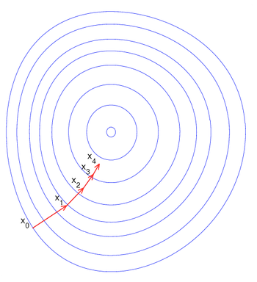

How to Train Neural Network
If we need to optimize a lot of w_{i} and b_{j} we need a smart algorithm to do so, e.g. the method of gradient descent:
Gradient of Loss (average over the input data)

Slide 27

How to Train Neural Network
When the input data size is large the calculation is too slow. A common solution is to use a random subset of input data instead:
This subset is called mini-batch. The method is called stochastic gradient descent (SGD).
Epoch: One cycle through the full training dataset. Training a NN usually requires quite a few epochs.
Gradient of Loss approximated by average over a subset of input data

Slide 28
Neural Network Parameters
When you train a NN you have to decide
Number of hidden layers and number of neurons for each hidden layer
Which activation function to use
Which loss function to use
How to minimize the loss function ...

Slide 29
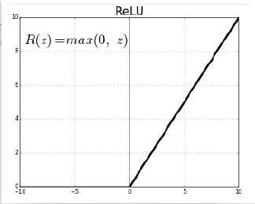
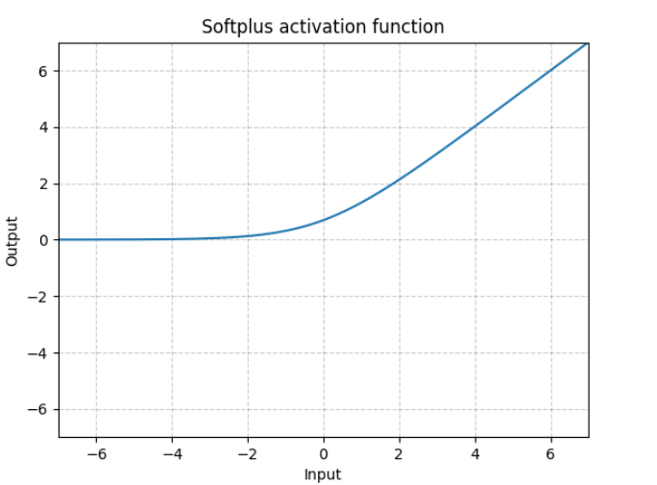

Activation Function
Two common activation functions are the rectified linear unit (ReLU) function and Softplus function

Slide 30


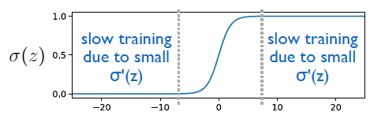
Loss Function
Training with MSE can be slow since the gradient depends on the slope of the activation function:
Courtesy of Prof. Kai-Feng Chen (NTU)

Slide 31




Loss Function
Another choice of loss functions is the (binary) cross entropy function
Courtesy of Prof. Kai-Feng Chen (NTU)

Slide 32
Solver choice
SGD is an easy and useful algorithm for minimizing the loss function, but there can be problems like slow training.
Many other choices of ‘solvers’. E.g.
Adam: Increase the ‘step size’ (learning rate) when gradient becomes smaller
L-BFGS: Find the extremum using (quasi) Newton’s method

Slide 33
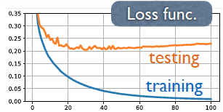
Regularization
As usual we need to be careful about overtraining (overfitting)
L1/L2 regularization: Add extra term λΣi|Wi| or λΣiWi² to the loss function
Number of epochs

Slide 34
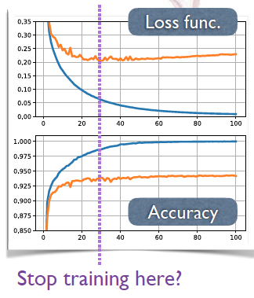
Early Stopping
Many packages include the option of an ‘early stopping’: Stop training when the model stops improving, either after certain number of consecutive iterations, or with a validation sample.
Number of epochs

Slide 35
Summary
To go beyond linear classification/regression there are many machine learning algorithms we can use, e.g. SVM, Decision Trees, NN
Many hyperparameters/methods to choose for each algorithm → need to tune/determine by validation.

Slide 36
Addendum
(Backpropagation?)

Slide 37
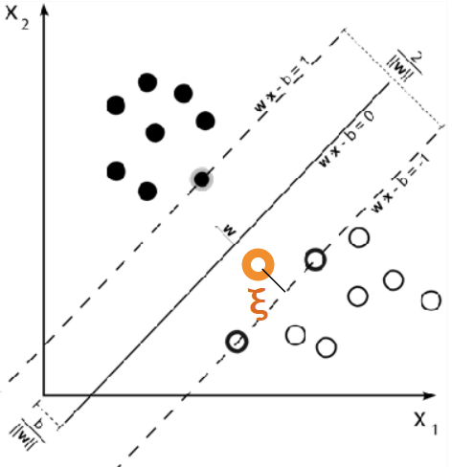


Backup: Soft margin
E.g. The max soft margin is determined by subject to
C is a (regularization) hyperparameter
For black dots (y=1)
For white dots (y=-1)

